Slide 1
Forecasting Chicago
Home Prices
Time Series Analysis and Forecasting
University of Chicago
December 11, 2020

Slide 2
Agenda
EDA
Future steps
Introduction
Modeling and Results

Slide 3
Introduction
Real estate prices are of great interest to current and prospective property owners, lenders and government.
Understanding evolving trends in price is extremely valuable, especially in a competitive, yet highly seasonal market like Chicago.
In this project, we forecast median home sale prices in the City of Chicago.

Slide 4
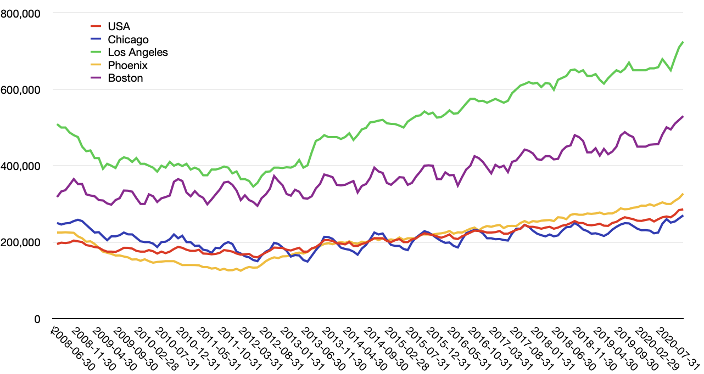
Chicago vs US cities
Like other cities with cold-climates, Chicago shows significant seasonal volatility.

Slide 5




Data Sources
Zillow (primary)
Feb 2008 – Jan 2020
139 observations
Complete
Mortgage Rate?
Google Trends
“Homes for Sale”, “Realtor”
Feb 2008 – Jan 2020
139 observations
Complete
CPI?

Slide 6
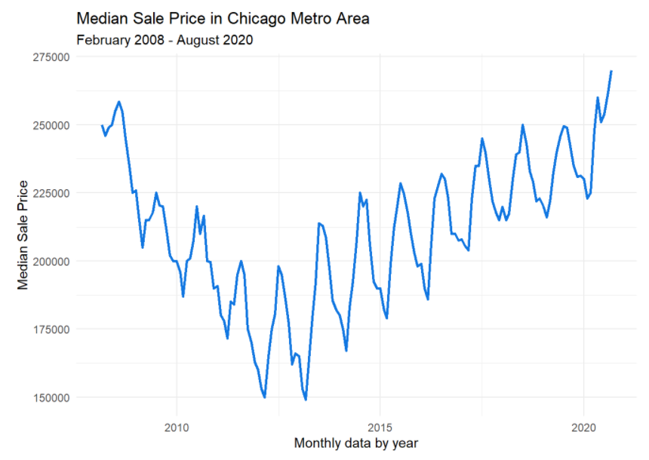
Exploratory Data Analysis
Notes:
Non-stationary
Unusual high seasonality
Two trends – down and up
The same magnitude

Slide 7
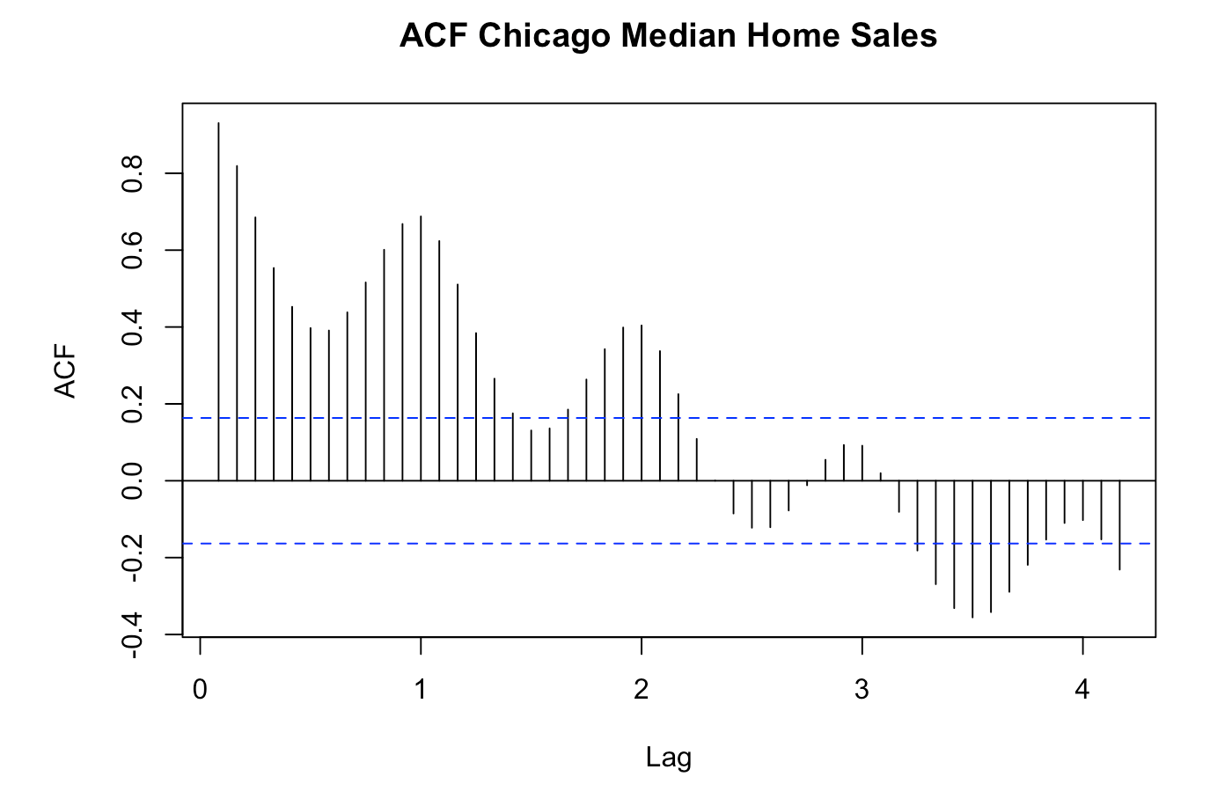
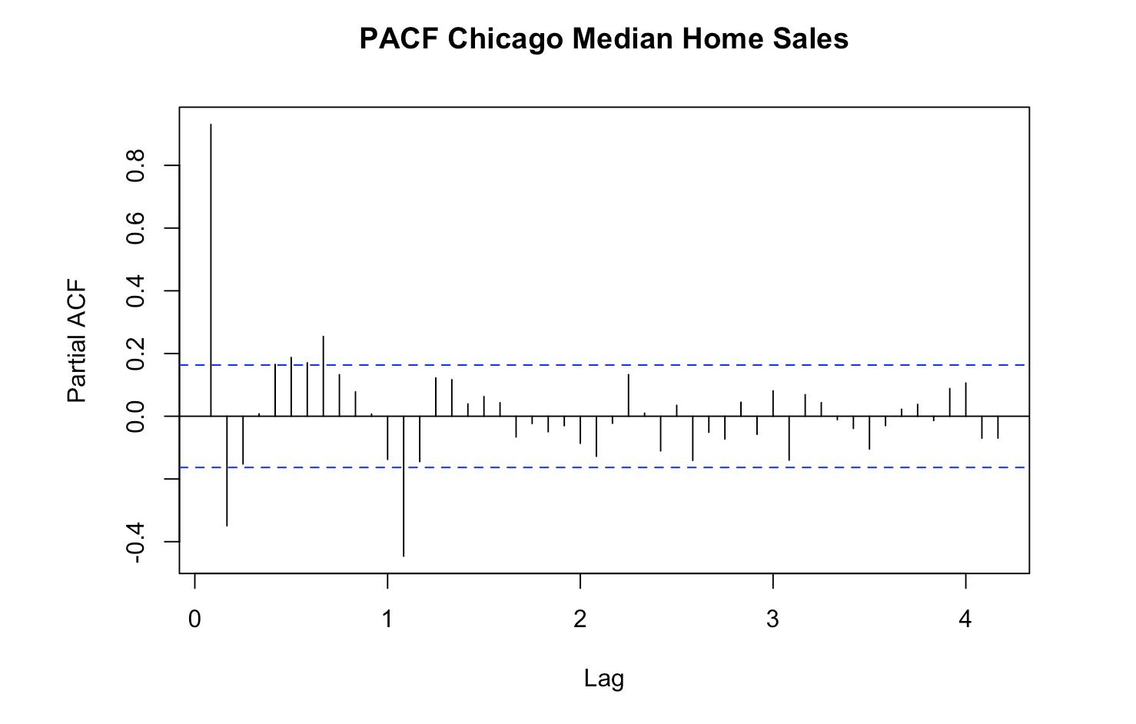
ACF & PACF

Slide 8
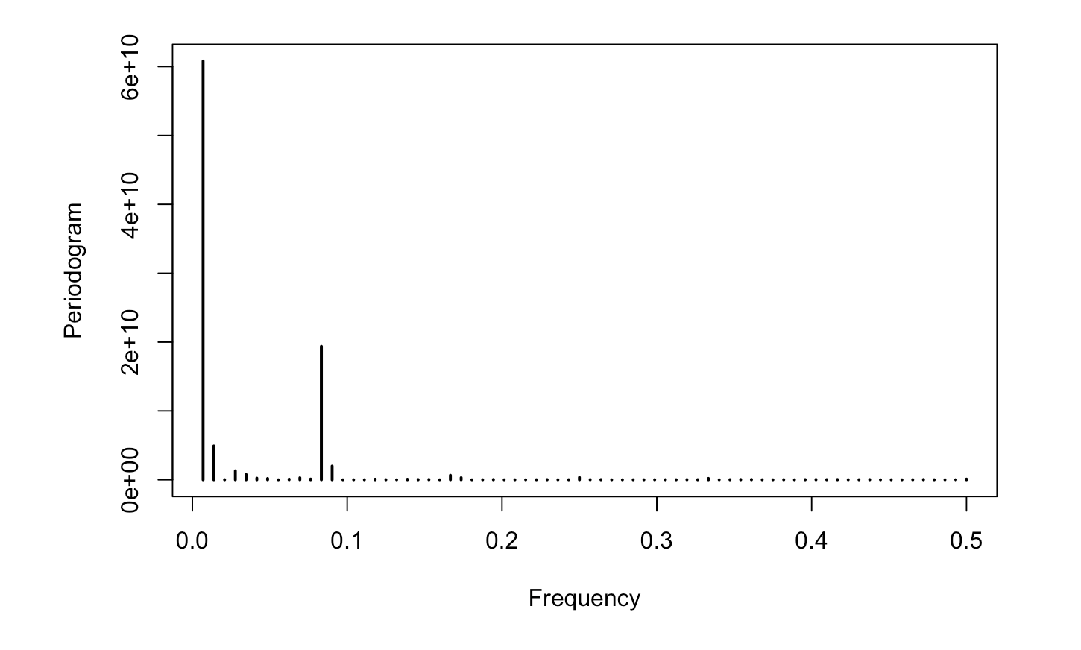
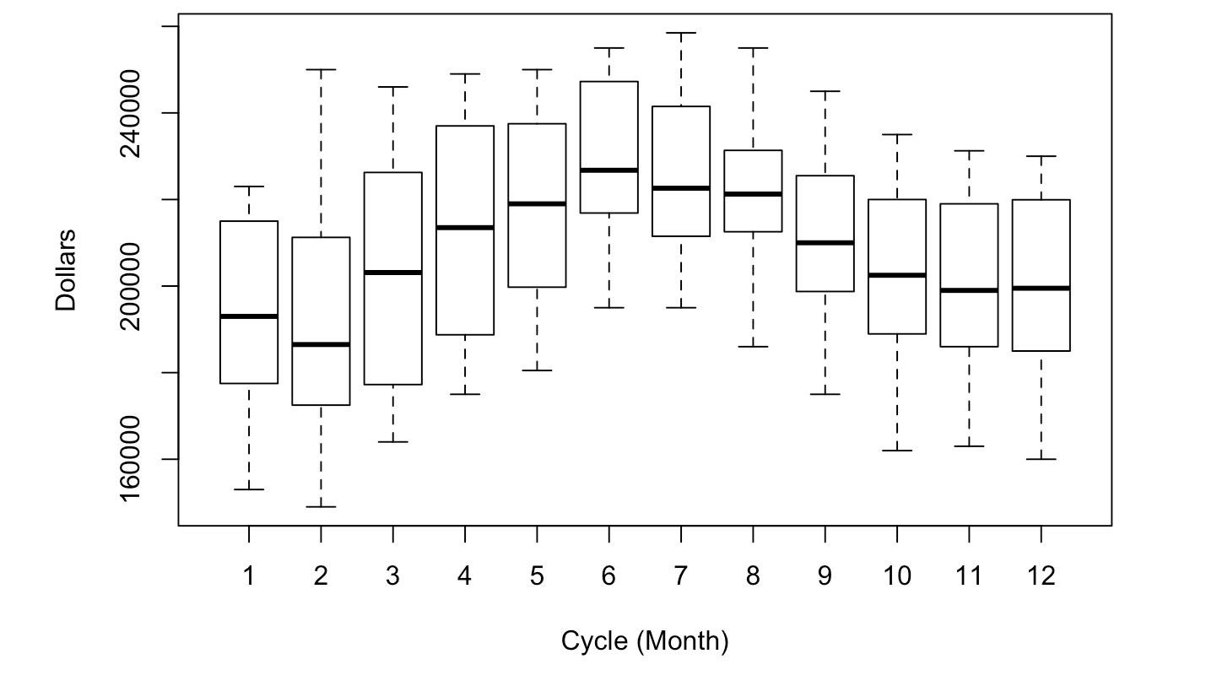
Seasonality

Slide 9
Model Selection
Model | Reason
Exponential Smoothing
sArima
Regression with ARMA errors
VAR
Dynamic Harmonic Regression
Prophet

Slide 10
Specifics about each model...
Notes:
https://www.cnn.com/2020/07/28/business/starbucks-earnings-coronavirus/index.html

Slide 11
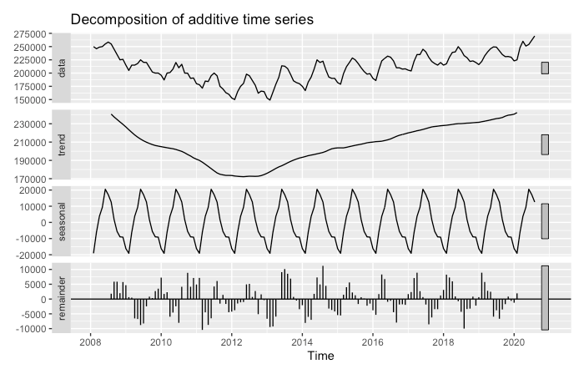
Exponential Smoothing Unaltered Data – Initial Impressions
Trend: Clear trend with a decrease during the housing recession, then additive increase thereafter.
Seasonality: Appears to be additive as well.
Remainder: Some clear seasonal autocorrelation left.

Slide 12
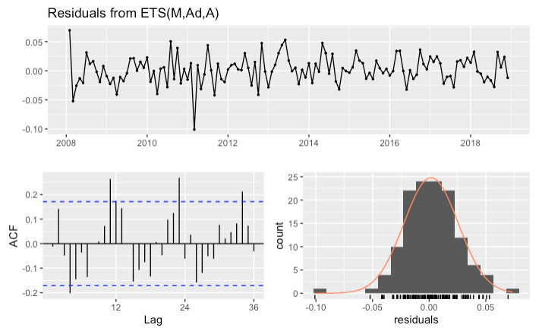
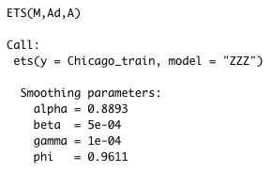
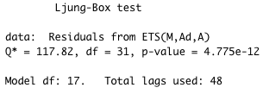
Exponential Smoothing ETS Auto-Generated Model
Comments: The ets function has returned a Multiplicative smoothing parameter model, with very low trend and seasonal effects. This is very surprising based on our initial observations of the data.
Based on the examination of the residuals, this is clearly not a good model. According to the Ljung-Box test, the residuals still have serial correlation. Also, it’s clear from the ACF chart the residual correlation is seasonal in nature.
We need to manually change the model parameters.

Slide 13
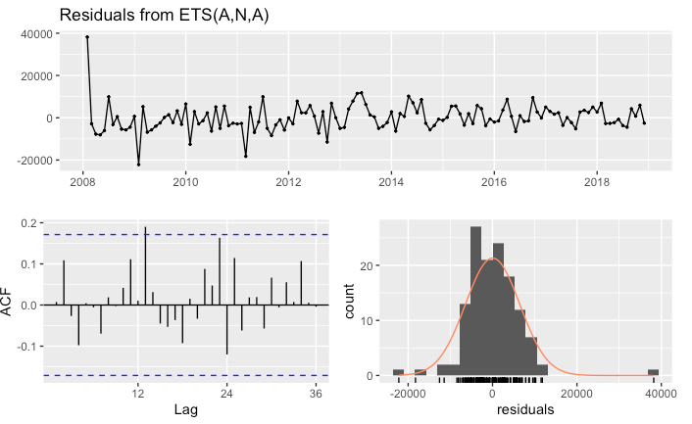
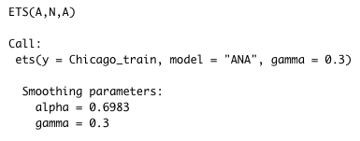
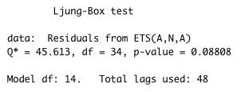
Exponential Smoothing ETS Manual-Generated Model
Based on our initial observation, we are set the ets model to an additive model with seasonality.
After various iterations, we arrived at the following parameters, which seem to work well.

Slide 14
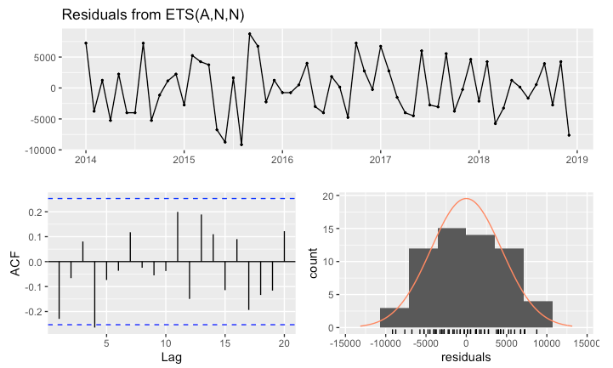
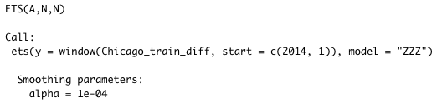
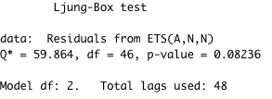
Exponential Smoothing ETS - Generated Model – Differenced Data
For further examination, we manipulated the data provided to the ets model. In this example, we use 1-degree differencing and seasonal differencing. We also only use housing prices after the recession.
This results in a very simple and uninteresting model. But, there is no serial correlation and the residuals look good. We will now compare the two models predictions.

Slide 15
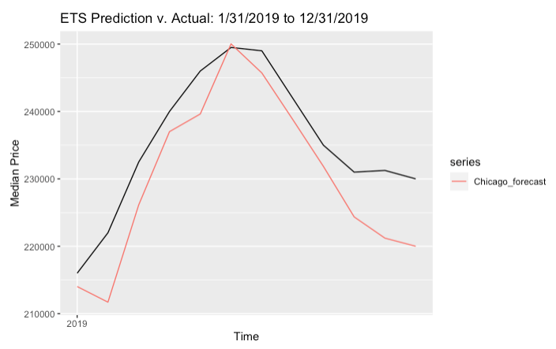
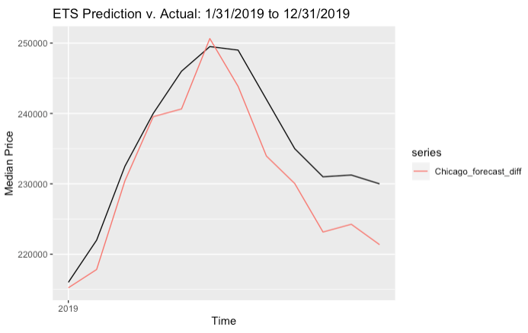
Exponential Smoothing ETS Models predictions comparison
Unaltered Data:
Differenced Data:
Conclusion: The model with the first-degree differencing and seasonal differencing performs better.

Slide 16
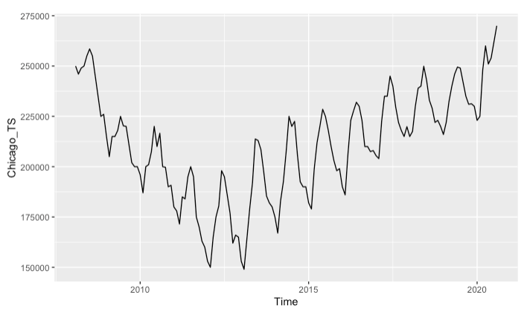
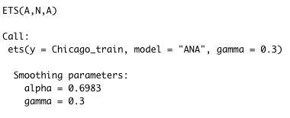
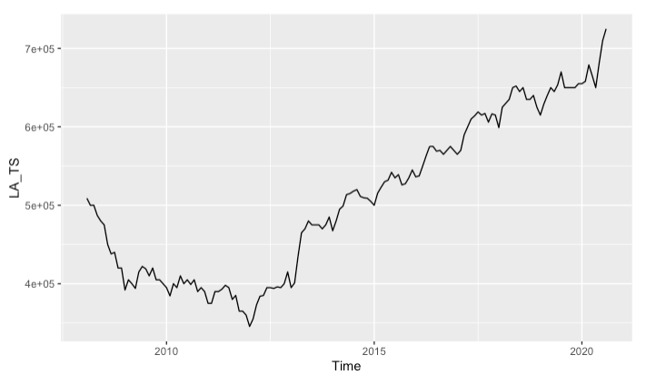
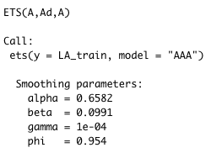
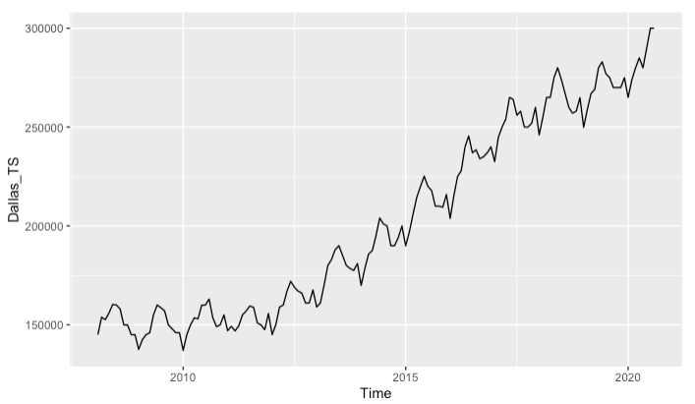
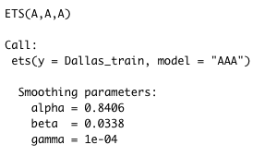
Exponential Smoothing City Comparison
Chicago
A benefit of exponential smoothing is how interpretable the model parameters are. As such, we provide a comparison of best models for
Chicago, Dallas and Los Angeles (constrained to Additive Only).
L.A.
Market Descriptions
Chicago: The alpha value indicates more weight to older values. No increase or decrease in trend. Very seasonal. Market Description: Stable market – Buy in the winter sell in the summer.
Los Angeles: The alpha value indicates more weight to older values. The beta value also indicates a slightly increasing slope. There is also a little bit of dampening. Market Description: Stable market with houses increasing in value, but increase is slowing down.
Dallas
Denver: The alpha value indicates more weight to newer values. The beta value also indicates a slightly increasing slope. There is also a little bit of dampening. Market Description: Less stable market with houses increasing in value and not appearing to slow.

Slide 17
Model Performance
Notes:
https://www.cnn.com/2020/07/28/business/starbucks-earnings-coronavirus/index.html

Slide 18
Next Steps
Notes:
https://www.cnn.com/2020/07/28/business/starbucks-earnings-coronavirus/index.html

Slide 19
Sources
GitHub repository

Slide 20




Our Team
Chris Reimann
Kyla Ronellenfitsch​
Oleksiy Anokhin​
Mike Thompson

Slide 21
Q & A

